Slide 1
5COSC020W DATABASE SYSTEMS – LECTURE 03
Logical Database Design – Mapping to a Logical Entity-Relationship Model

Slide 2
Lecture 03 – Outline
Relational Model
Relations to represent data: tables with records and fields.
Relating table with relational keys: primary keys and foreign keys.
Entity Integrity and Referential Integrity.
Logical Design for Relational Databases
Mapping Conceptual to Logical Entity-Relationship Model.
Mapping one-to-many relationships.
Mapping one-to-one relationships.
Mapping many-to-many relationships.
Mapping complex relationships: ternary and quaternary.
Mapping specialisations.

Slide 3
Phases and outputs of Database Design (recap)
Data Requirements
BUSINESS USER’S DATA NEEDS
to support business processes
☑
CONCEPTUAL DESIGN
CONCEPTUAL DATA MODEL OR CONCEPTUAL SCHEMA
of the data required by business users
☑
LOGICAL DESIGN (Mapping)
LOGICAL DATA MODEL OR LOGICAL SCHEMA
based on specific file data organisation (e.g. relational model)

PHYSICAL DESIGN
PHYSICAL OR INTERNAL SCHEMA
storage structures, file organizations, indexes, access paths
☑
DATABASE IMPLEMENTATION & QUERYING
DATABASE IMPLEMENTED & QUERIED IN DBMS
data structures, constraints, data values, data description

Slide 4
Classifying DBMSs based on Data Models (recap)
Relational Model or SQL Model (covered in lectures 01-07)
Structured Data as collection of tables with fields, records, PKs and FKs.
Uses high level Structured Query Language (SQL) for CRUD operations.
XML Model (covered in lectures 08-10)
Semistructured data as elements that can be nested to create tree structures.
Standard for structuring and exchanging data over the Web.
NoSQL Model (covered in lectures 11)
Key-value data model: each data value associated to unique key for fast retrieval.
Graph data model: data represented as graphs i.e. labelled nodes and edges.
Document data model: data as collection of documents in JSON or XML.
Object Model (not covered in this module)
Data as collection of objects (in classes) with properties & operations.

Slide 5
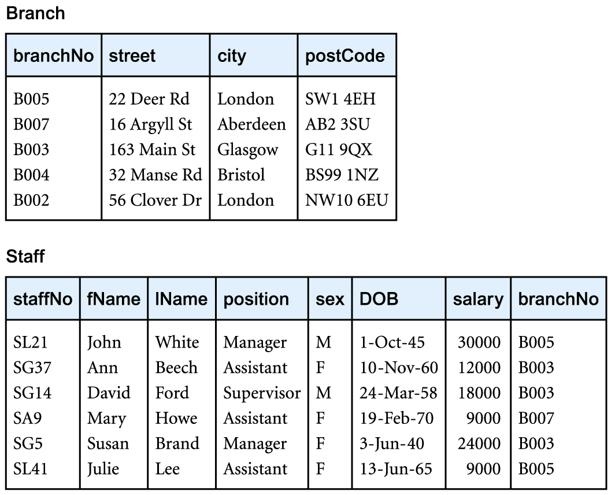
Relational Model – Starting with an example

Slide 6
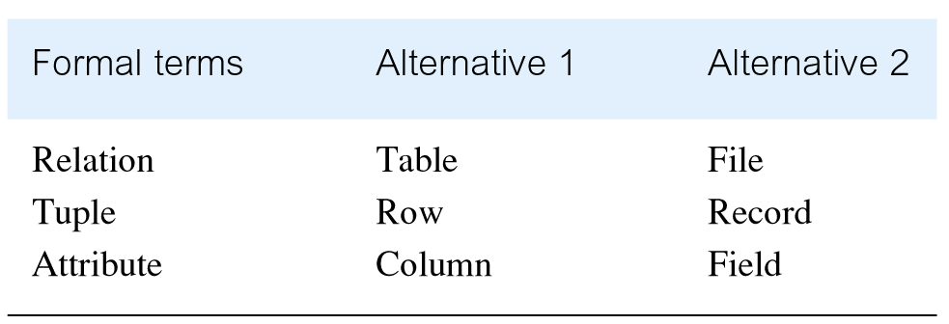
Relational Model – Terminology

Slide 7
Relational Model
Data stored as collection of relations (tables) interconnected with PKs and FKs that follow a set of Integrity Constraints.
Relation
Table with columns and rows.
Only applies to logical structure of the DB, not conceptual or physical.
Attribute
Named column of a relation that contains values in the domain of the attribute.
Domain: the set of allowable values for one or more attributes.
Degree: number of attributes in a relation.
Tuple
Row in a relation that contains the data values of a single record.
Cardinality: number of tuples in a relation

Slide 8
Essential properties of relations
Relational Schema:
Collection of named relations defined by a set of attributes & domain name pair.
Relation
Relation name is distinct from all other relation names in relational schema.
Each cell of relation contains exactly one atomic (single) value.
Attribute
Each attribute has a distinct name.
Values of an attribute are from the same domain.
Order of attributes has no significance.
Tuple
Each tuple is distinct; no duplicate tuples.
Order of tuples has no significance, theoretically.

Slide 9
Relational Keys
Superkey
Set of attributes that uniquely identifies a tuple within a relation.
Candidate Key
Minimal set of attributes that uniquely identifies each tuple within a relation.
PRIMARY KEY (PK)
Selected Candidate Key: unique and irreducible.
Selected minimal set of attributes that uniquely identifies each tuple within relation.
Alternate Key (AK)
Not selected Candidate Key.
Not selected minimal set of attributes that uniquely identifies each tuple within a relation.
FOREIGN KEY (FK)
Attribute, or set of attributes, within one relation that matches candidate key (most often the Primary Key) of another relation (possibly same).

Slide 10
Integrity Constraints
Null values
Value for an attribute that is currently unknown or not applicable for tuple.
Absence of a value, not the same as zeros or spaces, which are actual values.
Deals with incomplete or exceptional data.
Entity Integrity
In a relation, no attribute of a PK can be null.
Referential Integrity
The FK in a relation can either:
Be wholly null (if multiplicity allows);
Or match a candidate key value (most often the FK) of some tuple in its home relation.

Slide 11
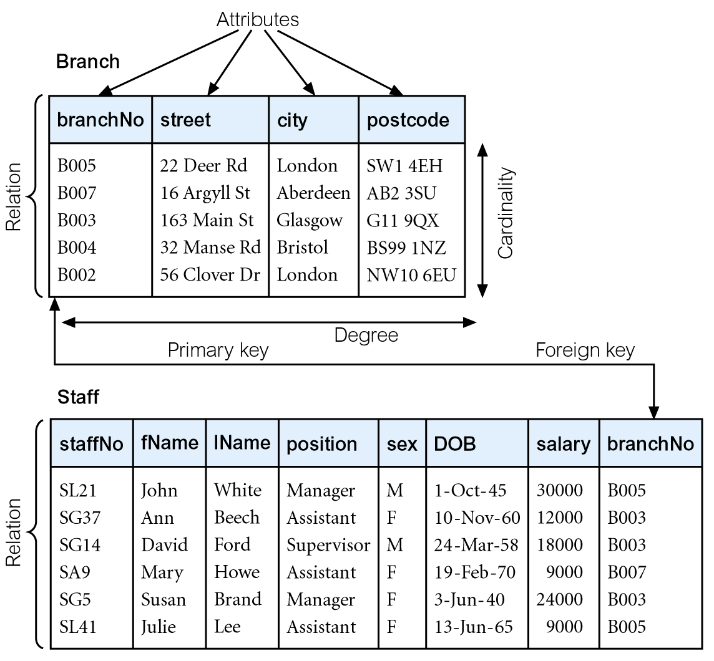
Relational Model – Recap
ENTITY INTEGRITY: values of a PK can never be null!
REFERENTIAL INTEGRITY:
values of a FK can either be null or match values of the PK they reference, nothing else!

Slide 12
Logical Mapping: from Conceptual to Logical
Logical Mapping
Convert a Conceptual EERD (high-level architecture) to a Logical ERD (a relational schema directly implementable in SQL)
10 Mapping rules ⚠️Only consider cardinality
One-to-Many relationships
One-to-One relationships mandatory on both sides
One-to-One relationships optional on one side
One-to-One relationships optional on both sides
Many-to-Many relationships
Complex relationships: ternary and quaternary
Specialisations with {Mandatory, And}
Specialisations with {Optional, And}
Specialisations with {Mandatory, Or}
Specialisations with {Optional, Or}

Slide 13
1) Mapping One-to-Many Relationships – Rule
Create 2 tables based on the 2 original entities.
Parent table on the “one” side.
Child table on the “many” side.
Create FK on the Child table as a copy of the PK of the Parent table.
FK of the Child Table references the PK of Parent Table.

Slide 14
1) Mapping One-to-Many Relationships – Example
Staff
is allocated
Laptop
Conceptual
staffNo{PK}
fName
sName
email
0..1
0..*
serialNo {PK}
model
screenSize
Parent
Child
is allocated
Staff
Laptop
Logical
staffNo{PK}
fName
sName
email
0..1
0..*
serialNo {PK}
model
screenSize
staffNo{FK}
Tables
Staff (staffNo{PK}, fName, sName, email)
Laptop (serialNo {PK}, model, screenSize, staffNo{FK})

Slide 15
2) Mapping One-to-One Relationships Mandatory on Both Sides Rule
Merge 2 entities into one table with all attributes under new table.
Choose one PK from the two original PKs.
Make the other one the AK.

Slide 16
2) Mapping One-to-One Relationships Mandatory On Both Sides Example
Staff
is allocated
Laptop
staffNo{PK}
fName
SName
email
1..1
1..1
serialNo {PK}
model
screenSize
Conceptual
Staff
staffNo{PK}
fName
sName
Email
serialNo{AK}
model
screenSize
Logical
Tables
Staff (staffNo{PK}, fName, sName, email, serialNo{AK}, model, screenSize)

Slide 17
3) Mapping One-to-One Relationships Optional on One Side Rule
Create 2 tables based on the 2 original entities.
Parent table on the “mandatory” side.
Child table on the “optional” side.
Create FK on the Child table as a copy of the PK of the Parent table.
FK of the Child Table references the PK of Parent Table.

Slide 18
3) Mapping One-to-One Relationships Optional on One Side Example
is allocated
Staff
Laptop
staffNo{PK}
fName
sName
email
1..1
0..1
serialNo {PK}
model
screenSize
Conceptual
Parent
Child
is allocated
Staff
Laptop
Logical
staffNo{PK}
fName
sName
email
1..1
0..1
serialNo{PK}
model
screenSize
staffNo{FK}
Tables
Staff (staffNo{PK}, fName, sName, email)
Laptop (serialNo{PK}, model, screenSize, staffNo{FK})

Slide 19
4) Mapping One-to-One Relationships Optional on Both Sides Rule
Create 2 tables based on the 2 original entities.
Parent table on the “more mandatory” side.
Child table on the “more optional” side.
Create FK on the Child table as a copy of the PK of the Parent table.
FK of the Child Table references the PK of Parent table.

Slide 20
4) Mapping One-to-One Relationships Optional on Both Sides Example
is allocated
Staff
Laptop
Conceptual
staffNo{PK}
fName
sName
email
0..1
0..1
serialNo {PK}
model
screenSize
Parent
Child
is allocated
Staff
Laptop
Logical
staffNo{PK}
fName
sName
email
0..1
0..1
serialNo{PK}
model
screenSize
staffNo{FK}
Tables
Staff (staffNo{PK}, fName, sName, email)
Laptop (serialNo{PK}, model, screenSize, staffNo{FK})

Slide 21
5) Mapping Many-to-Many Relationships – Rule
Create 3 Tables.
Create 2 original Parent tables based on original entities.
Create a Link table associated to the two Parent tables through two 1:M relationships
Link table is the Child table of both Parent tables.
FKs of Link Child table reference the PKs of the Parent tables.
PK of Link Child table combination of the 2 PKs of the Parent Tables.
Compound PK: if combination of 2 PKs will never be repeated.
Composite PK with additional date (and possibly time): if combination of 2 PKs can be repeated.

Slide 22
5) Mapping Many-to-Many Relationships – Example
is allocated
Conceptual
Staff
Laptop
staffNo{PK}
fName
sName
email
0..*
1..*
serialNo {PK}
model
screenSize
Parent
Parent
Staff
Laptop
Logical
staffNo{PK}
fName
sName
email
serialNo{PK}
model
screenSize
Child
Child
1..1
Laptop_Staff_Alloc
1..1
(staffNo{FK}
serialNo{FK}
dateGivenOut){PK}
Compound or Composite PK?
is for
is for
1..*
0..*

Slide 23
6) Mapping Complex Relationships: Ternary & Quaternary Rule
For ternary, create 4 Tables.
Create 3 original Parent tables based on original entities.
Create a Link table associated to the three Parent tables through three 1:M relationships
Link table is the Child table of all three Parent tables.
FKs of Link Child table reference the PKs of the Parent tables.
PK of Link Child table combination of the 3 PKs of the Parent Tables.
Compound PK: if combination of 3 PKs will never be repeated.
Composite PK with additional date (and possibly time): if combination of 3 PKs can be repeated.

Slide 24
6) Mapping Complex Relationships: Ternary & Quaternary Example
Staff
Uses
Laptop
staffNo{PK}
fName
Sname
email
0..*
0..*
Conceptual
serialNo{PK}
model
screenSize
0..*
Project
projId{PK}
pName
Parent
Child
Child
Parent
Usage
Logical
Staff
uses
is used
Laptop
(staffNo {FK}
serialNo {FK}
projId {FK}
dateGiven ){PK}
staffNo{PK}
fName
Sname
email
1..1
0..*
0..*
1..1
serialNo{PK}
model
screenSize
0..*
Child
makes use of
1..1
Parent
Compound or Composite PK?
Project
projId{PK}
pName

Slide 25
7) Mapping Generalisations with {Mandatory, And} – Rule
Merge all entities into one table with all attributes under new table.
Create PK of the new table as the PK of the generalised entity.
Add flags to differentiate between records of previous specialised entities.

Slide 26
7) Mapping Generalisations with {Mandatory, And} – Example
Staff
Conceptual
staffNo{PK}
staffName
{Mandatory, And}
Permanent
Consultant
permSalary
consultRate
Staff
Logical
staffNo{PK}
staffName
permFlag
permSalary
consultFlag
consultRate
Tables
Staff (staffNo{PK}, staffName, permSalary, consultRate, permFlag, consultFlag)

Slide 27
8) Mapping Generalisations with {Optional, And} – Rule
Create 2 tables
One table for general entity which becomes the Parent table.
One table for both specialised entities merged together which becomes the Child table.
Create ONE one-to-one relationship optional on one side between the 2 tables
FK of the Child table references PK of the Parent table.
PK of the Child table is the same as the PK of Parent table.
Add flags to differentiate between records of previous specialised entities.

Slide 28
8) Mapping Generalisations with {Optional, And} – Example
Staff
staffNo{PK}
staffName
Conceptual
{Optional, And}
Permanent
Consultant
permSalary
consultRate
Parent
Child
StaffType
staffNo{PK}{FK}
permFlag
permSalary
consultFlag
consultRate
Logical
Staff
can be
staffNo{PK}
staffName
1..1
0..1
Staff (staffNo{PK}, staffName)
StaffDetails (staffNo{PK}{FK}, permFlag, permSalary, consultFlag, consultRate)
Tables

Slide 29
9) Mapping Generalisations with {Mandatory, Or} – Rule
Create 2 separate tables
One table for each of the specialised entities with the attributes of the general entity also added.
PK for both tables is the PK of original general entity.
Each table have their own relationships with the rest of the logical schema
The relationships that were associated to the original general entity are doubled up.
The relationships that were associated to each specialised entities remain the same.

Slide 30
9) Mapping Generalisations with {Mandatory, Or} – Example
Staff
staffNo{PK}
staffName
Conceptual
{Mandatory, Or}
Permanent
Consultant
permSalary
consultRate
Logical
PermStaff
ConsultStaff
staffNo{PK}
staffName
permSalary
staffNo{PK}
staffName
consultRate
PermStaff (staffNo{PK}, staffName, permSalary)
ConsutlStaff(staffNo{PK}, staffName, consultRate)
Tables

Slide 31
10) Mapping Generalisations with {Optional, Or} – Rule
Create 2 tables
One table for general entity which becomes the Parent table.
One table for each of the specialised entities, which becomes the Child table respectively.
Create TWO one-to-one relationships optional on one side between the Parent table and the 2 respective Child tables
FK of each Child table references PK of the Parent table.
PK of each Child table is the same as the PK of Parent table.

Slide 32
10) Mapping Generalisations with {Optional, Or} – Example
Staff
Conceptual
staffNo{PK}
staffName
{Optional, Or}
Permanent
Consultant
permSalary
consultRate
Parent
Staff
Parent
Logical
1..1
staffNo{PK}
staffName
1..1
can be
can be
Child
0..1
0..1
Child
PermStaff
ConsultStaff
staffNo{PK}{FK}
permSalary
staffNo{PK}{FK}
consultRate

Slide 33
Step-by-step Approach to Logical Mapping
Map specialisations (rules 7, 8, 9 or 10)
Consider constraint and apply appropriate rule.
Map one-to-one relationships mandatory on both sides (rule 2)
Merge 2 entities into one table, select PK and AK.
Map complex & many-to-many relationships (rules 5 or 6)
Reproduce original entities and make them parent tables.
Introduce link table as a child, define new multiplicities and define FKs and PK.
Map one-to-many relationships and one-to-one relationships that are optional on one side or on both sides (rules 1, 3 or 4)
Reproduce original entities, make one the parent table, make the other the child.
Introduce FK in the child table to reference PK of the parent table.

Slide 34
References and Essential Readings
Module Reading List: https://rl.talis.com/3/westminster/lists/2CAA7D6B-DCAD-AB71-C97B-7FEFCB499C28.html
Connolly, T. & Begg, C. E. (2015). Database systems: a practical approach to design, implementation and management. 6th Edition (Global Edition). Pearson Education. Ch. 1, 12, 13, 16.
Elmasri, R. & Navathe, S. (2017). Fundamentals of Database Systems. 7th Edition (Global Edition). Pearson Education. Ch 9.

